Slide 1


Weekly progress
Team: 5G

Slide 2
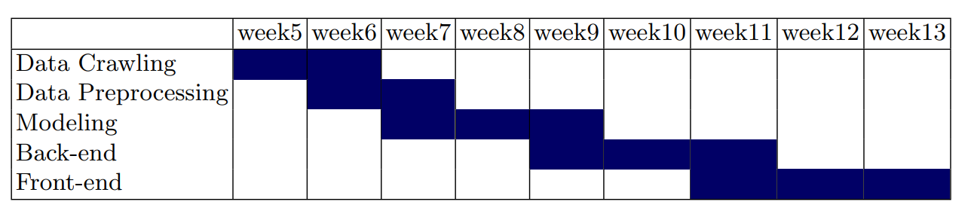
Part 2
Timeline
Progress schedule

Slide 3
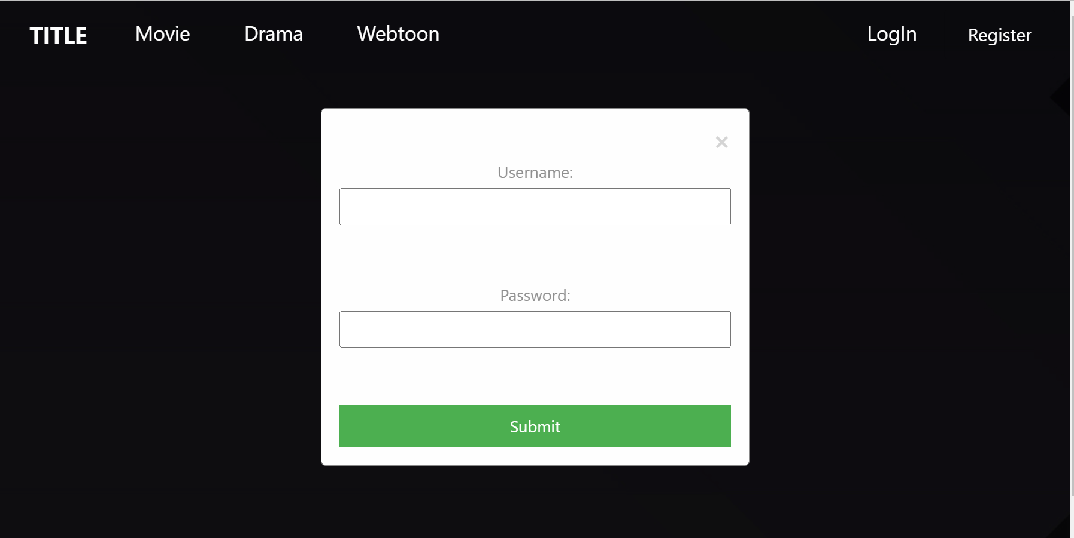
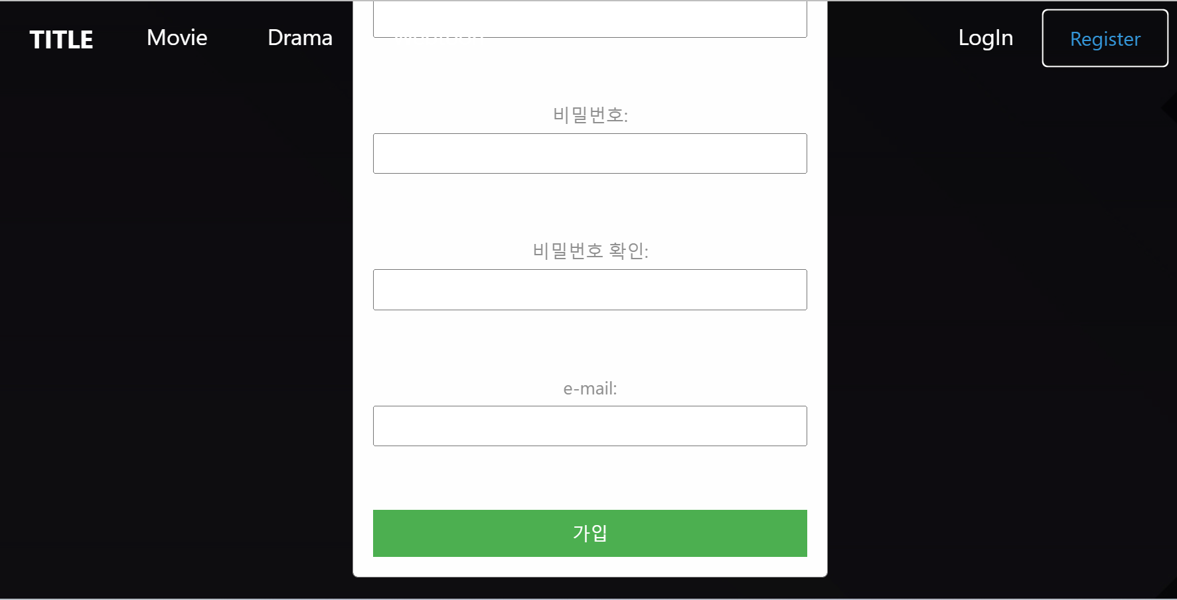
Part 3
Finished
Notes:
We managed to construct a database in the server. We used amazon lightshail, provided by the amazon web service(aws), to create server instance called LAMP(PHP 8). This instance includes MariaDB, which is basically same as MySQL, and phpMyAdmin and so on.

Slide 4
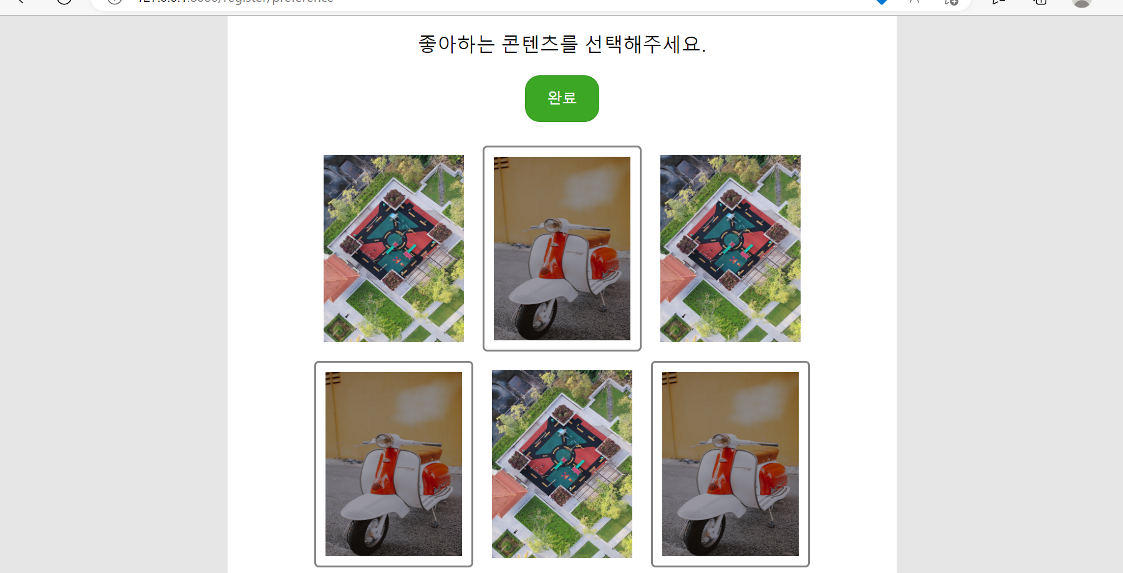
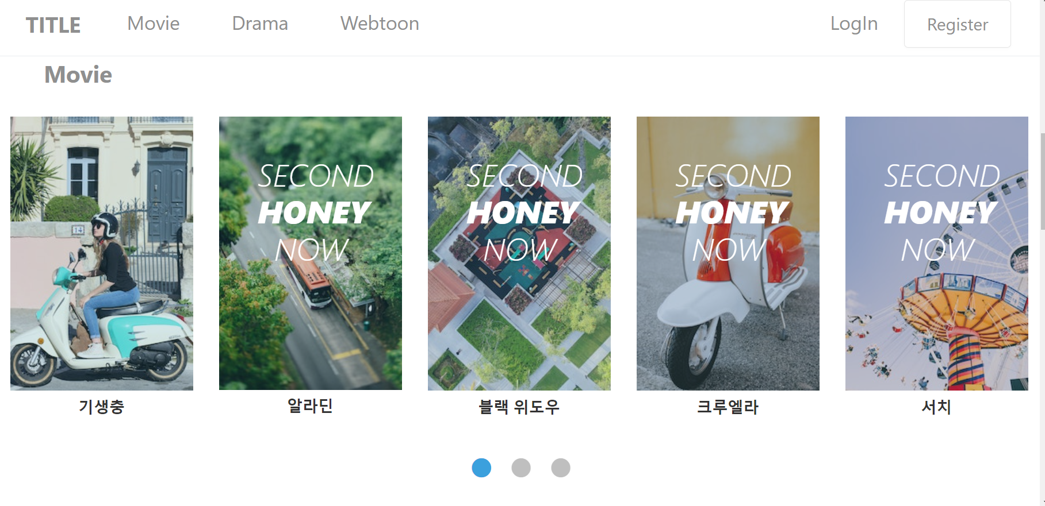
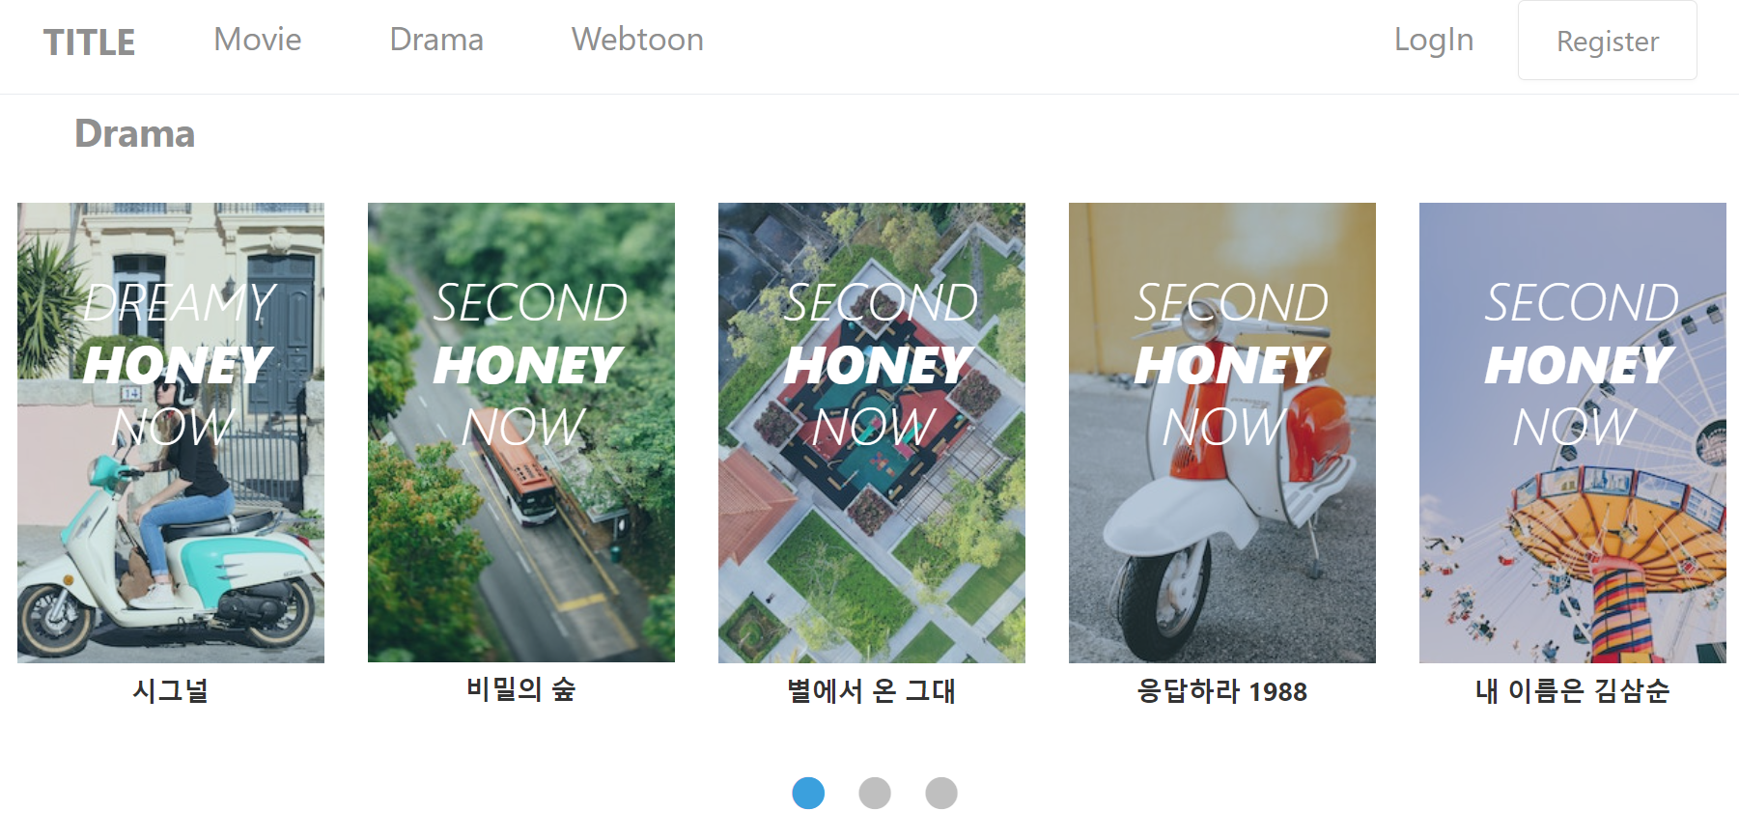
Part 3
Working on
Notes:
We added network rules on this instance to open ports for using MySQL(port=3306), so that we can remotely connect MySQL server from other sources.

Slide 5
Part 3
To do
Linking between frontend and backend
Search Engine
Notes:
We added network rules on this instance to open ports for using MySQL(port=3306), so that we can remotely connect MySQL server from other sources.

